Slide 1





OCA
LOVE JOY
Your company in the clouds
Notes:
Give them energy, wake up audience

Slide 2


Overview
Eva's story
Problem
Proposal
Promise
Proof
Our Journey
Notes:
run through quick

Slide 3

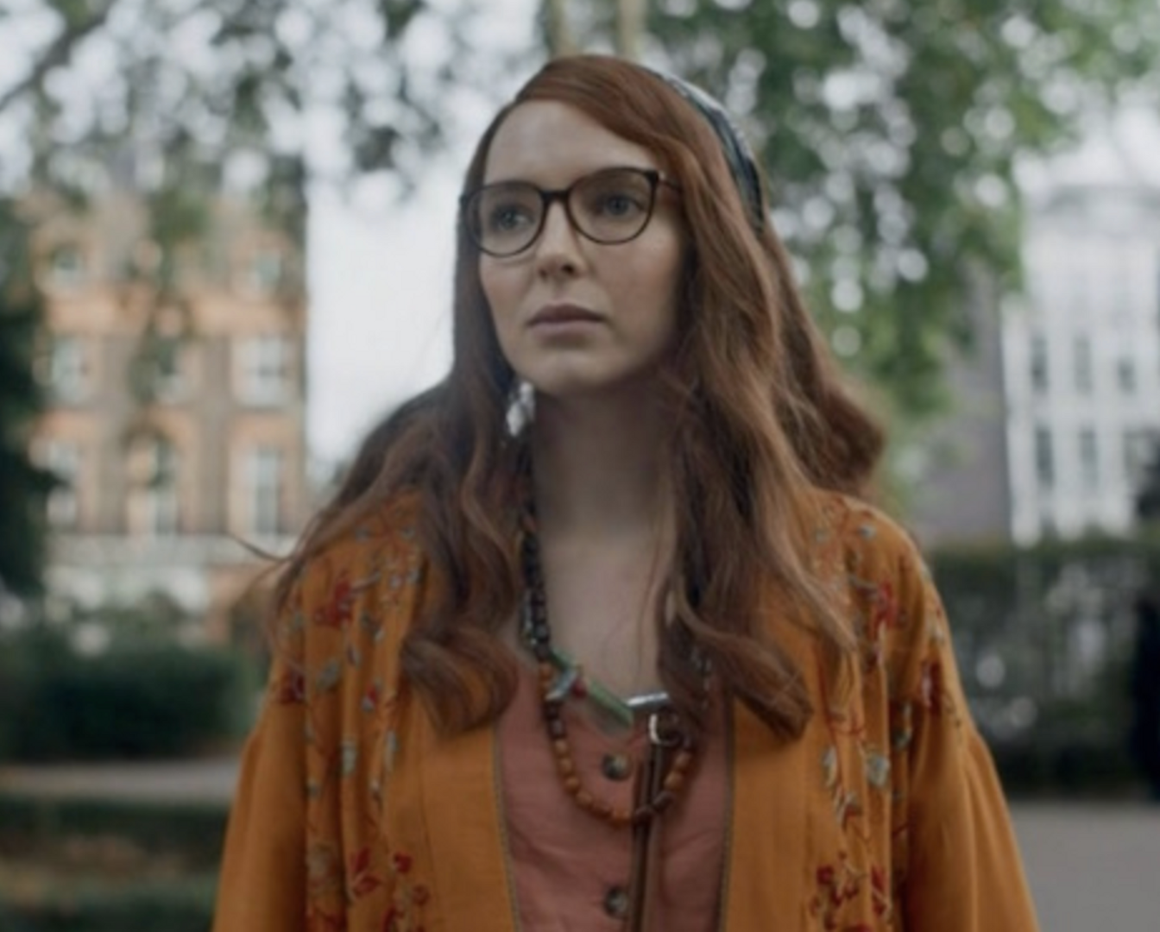

Eve's Story
Eve is a young lady with anxiety, paranoia and OCD. Over time she has learnt her triggers and developed her own coping techniques, but today she will be pushed to her limits as she has to fly to Jamaica to see her nan.
Usually she fly's with her family but today she is alone. Her journey starts off alright but as crowds swam, sires ring off, tensions build and her heart races.
Thats when she talks to Love Joy, her digital companion in the clouds.
Notes:
Eve is a young lady with anxiety, paranoia and OCD.
Flying alone
Talks to love joy

Slide 4




Our Problem
The 21st century is very inclusive, we have the technology to aid nearly every aspect of our lives and travel should not be left out.
We all desire to travel safely and comfortably, we all want to be treated fairly and have equal opportunities no matter what our mental health is .
Our product focus on delivering a digital campion to enable and empower people like eve, opening the world of travel up with no borders.
Notes:
The 21st century is very inclusive,
We all desire to travel safely and comfortably,
Our product focus on delivering a digital campion

Slide 5
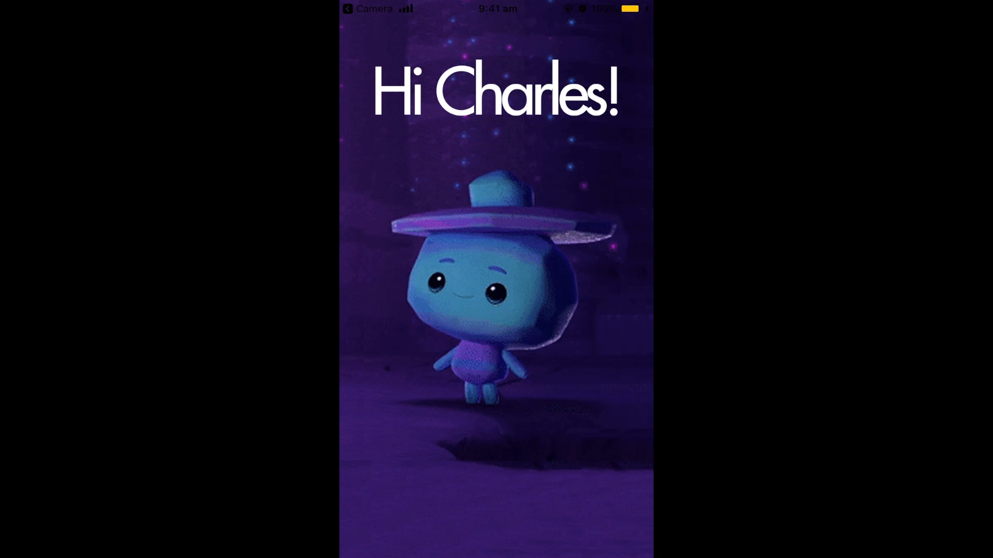
Here’s Lovejoy!
A PORTABLE COMPANION
Which you can talk to throughout your entire journey
ACCESSABILITY AID
For people with mental health making them feel safe during travel
Notes:
As you can see Eve is able to talk to Lovejoy during her time of distress. And when this doesn’t work, there’s an additional swipe card feature where eve can get any extra tips like breathing technique and self-care

Slide 6



Aspects of Technology
OUR 3 KEY TECHNOLOGY
React-Native
Google Dialogflow
Google Assistant
Notes:
We combined React-Native and Google Dialogflow to create a customizable mobile application as well as a stand-alone google assistant application

Slide 7




Our Journey
WHAT REALLY HAPPEND
ARRIVAL
DECISIONS
SLEEP!
MVP
Got to the hackathon pitched an idea and charles stepped up
Decided on an idea (LoveJoy) and started hacking!
Went and napped
Completed the MVP and now we are here
Notes:
We arrived at the hackathon, the scope was quite broad so we came up with lots of ideas. In the end we decided to go for LoveJoy! During the hackathon we learned how to use Dialogflow and integrated it with react native. We came across with some issues with voice on the react app but in the end we came up with a solid mvp after a well deserved nap!

Slide 8


It is estimated that 1 in 6 people in the past week experienced a common mental health problem
13% global population with disorder (2017) = 970 million
https://ourworldindata.org/mental-health
Notes:
it help eve but there are so many more to help and that our goal

Slide 9
OCA
Thank you
Love joy, your company in the clouds

